Slide 1
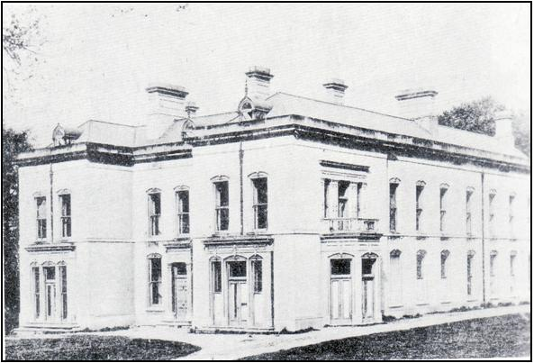
Coal Fortunes, Wealthy Heiresses & Noble Families
Hetton’s Royal Connections
Hetton’s Royal Connections
Hetton Hall

Slide 2
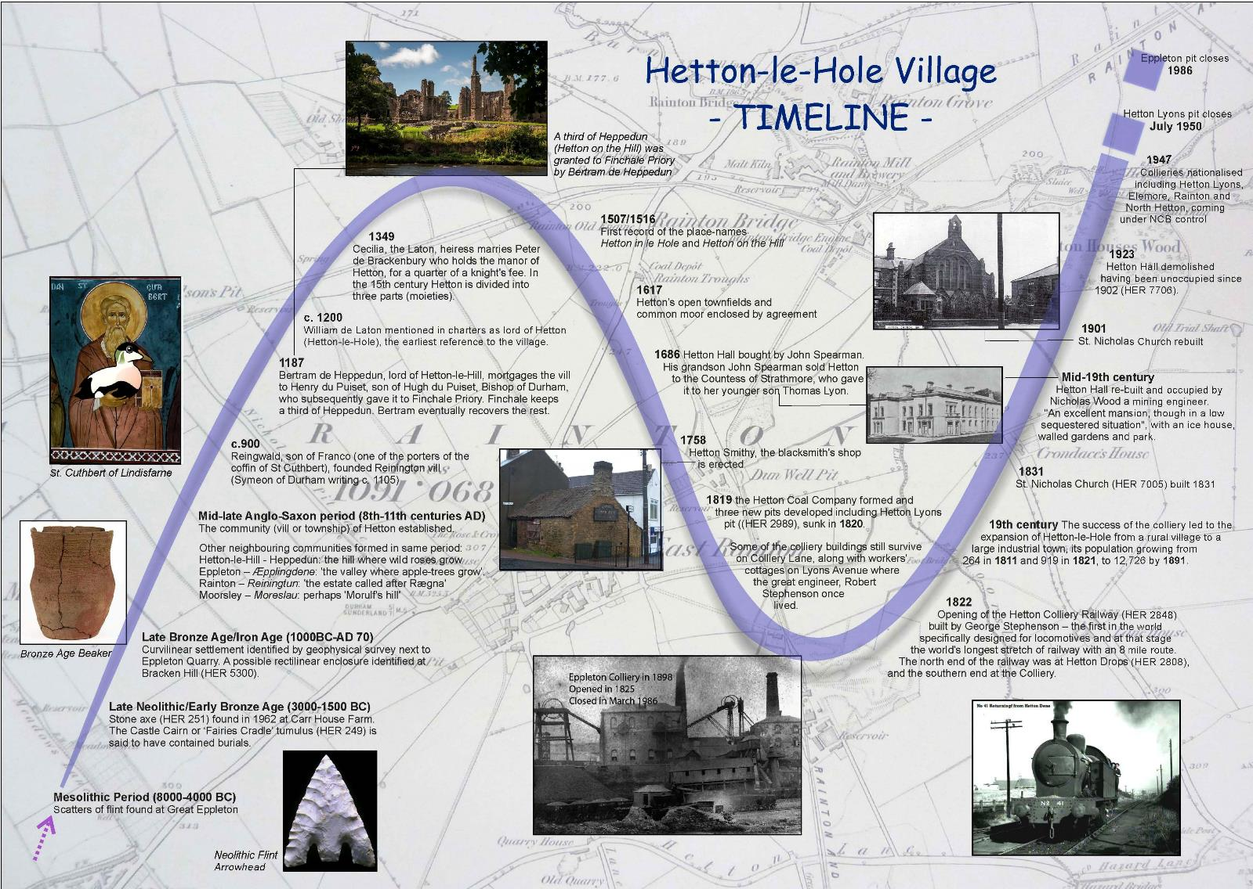

Slide 3
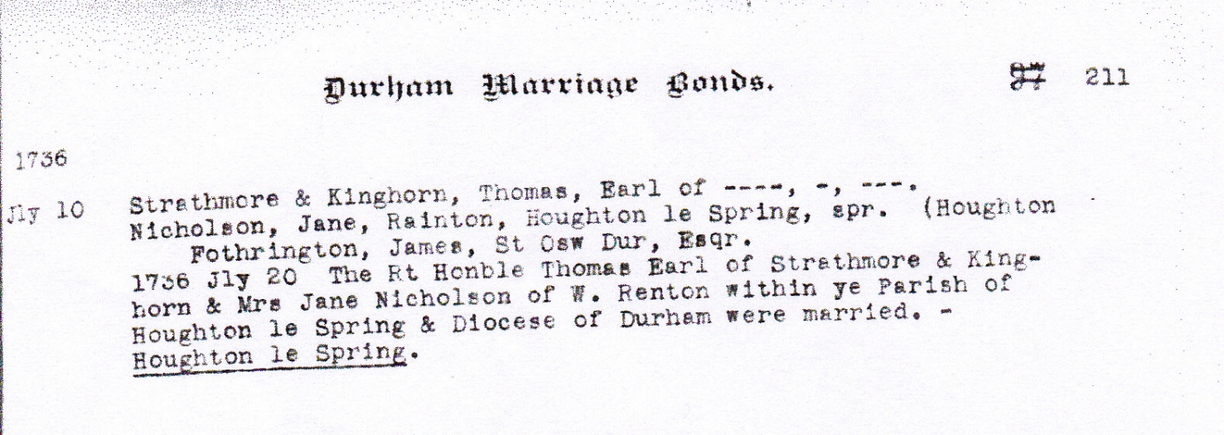
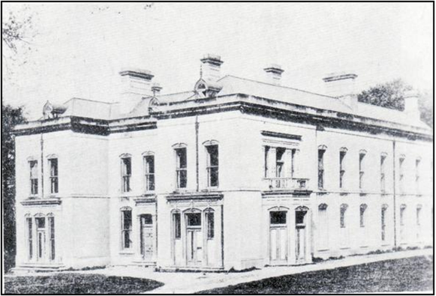
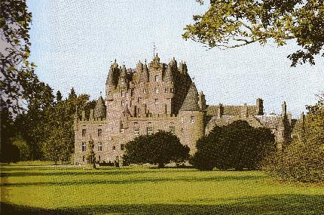
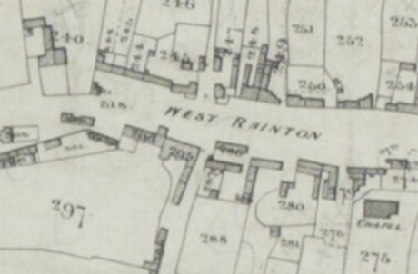
THE ROYAL CONNECTION TO HETTON-LE-HOLE
Many people who live in Hetton-le-Hole and surrounding villages are aware that the town had for many years at least one royal connection, namely the Queen Mother. Just how this connection came about is not known to many and hopefully the following talk will provide the answer.
Jane (Jean) Nicholson
West Rainton, Houghton-le-Spring
Heiress to the
Sir John Duck Fortune
The Lyon Family
Thomas 8th Earl of Strathmore & Kinghorn, Scottish Nobility
Hetton Hall
The Old Manor House,
West Rainton, Co Durham
Glamis Castle, Angus, Scotland

Slide 4
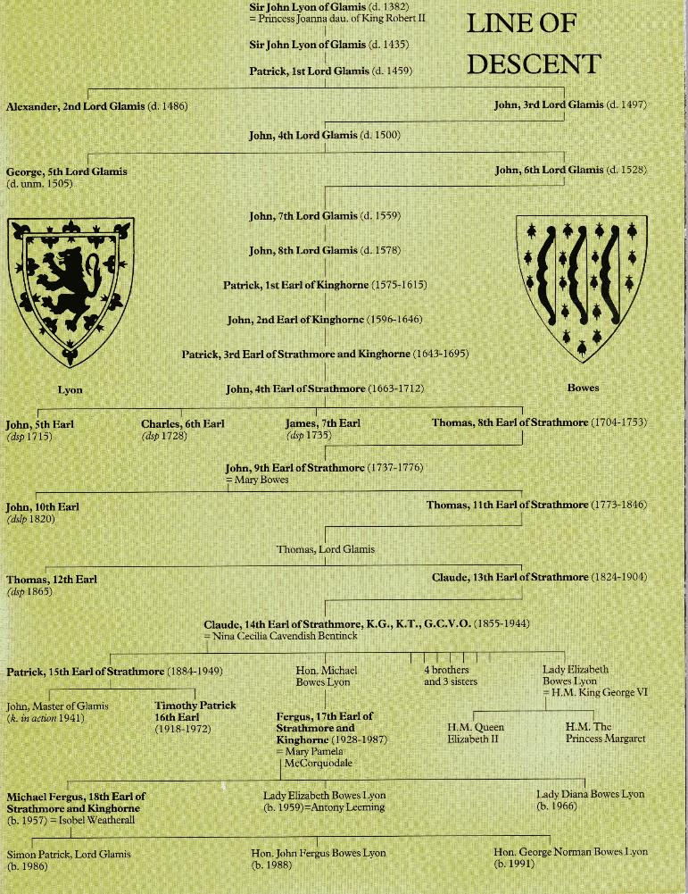
Origins of the Clan
The origin of the Lyon family is uncertain, it seems that they were of Celtic descent as far back as the 4th century, however, it is generally accepted that the Lyon’s descend from a French family called de Léon. At the end of the eleventh century they come north with Edgar, son of Malcolm III of Scotland to fight against his uncle, Donald Bane. Edgar was victorious and the de Leons received lands that were later called Glen Lyon in Perthshire. It was many centuries later in the 14th century when Sir John Lyon founded a line of feudal barons and later earls centred around Glamis.
THE LYONS FAMILY
Patrick Lyon, 1st Lord of Glamis, was connected to the English Parliament by being granted a Peerage in 1445, even though he had been held for ransom by the English as a hostage for King James I of Scotland. By 1450 he was well established in the English Court having been appointed as a Privy Councillor and Master of the Household. He became very wealthy and as a result used some of this wealth to add to the castle and give his family some stability.
The 2nd Earl of Kinghorne, another John, was recognised as the wealthiest Peer in Scotland, and he left it the poorest. The 3rd Earl started the families increasing links with England when he married Helen daughter of the Earl of Middleton and managed to pay off the debts. The 4th Earl of Kinghorne succeeded his father and married Lady Elizabeth Stanhope, they had seven sons, two of whom became Lord Glamis, but predeceased their father, and four sons who succeeded to the Earldom.
Political events caused mixed fortunes for the family when the 5th Earl promoted the family’s royalist sympathies by joining the Jacobite cause, resulting in his death at the Battle of Sheriffmuir in 1715. Charles the 6th Earl of Strathmore, not sharing the same royalist sympathies with his brother, allowed him to look after the estates well. He married Lady Susan Cochrane in 1725, but three years later tragedy struck. In 1728 following a funeral he was killed in a drunken brawl being run through by a sword. Thus the 7th Earldom passed to James ,the younger brother of Charles, of whom little is known, he died in 1735 without issue and the Earldom passed to his younger brother Thomas who became the 8th Earl of Strathmore and Kinghorne. This is where the Hetton connection with the Lyon family began.

Slide 5
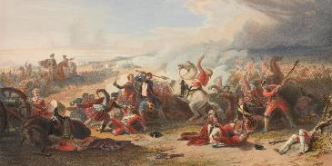
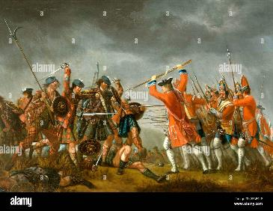
THOMAS LYON 8th EARL FAMILY IN Co DURHAM
The Scottish nobility, including the Lyon family were at some point caught up in the factional struggles and the political misfortunes after 1707 (Act of Union). Generations of weak kings in Scotland made Scotland helpless in a number of ways. The country was virtually cut in two, with a cohesive lowland area where the people had lost their old ethnic loyalties and a Highland region still pursuing the clan system, with its oath of allegiance to the clan chief rather than the king. Local people still gathered around local lords, who would offer protection only so long as the peasants continued to pay rents for their houses and land. Thus the Lords were overly dependent on paltry rent payments, as well as payments in kind, as their main source of income. Their overall wealth began to diminish as a consequence, and variations in the way each estate was run, did nothing to hold together the tenuous aspects of the law, which reverted to a local level in and around Glamis estates.
The area around Glamis, seat of the Strathmore's must have been a fairly lawless place, as once or twice a year great numbers of Highlanders made a descent into the fringe lowland areas in Perthshire and Fifeshire, to plunder. Numerous bands of vagrants attacked both householders and travellers alike, and extortion of the populace was rife, while the landscape swarmed with idle vagabonds, that the law was unable to restrain.
It was to be 40 years after the Act of Union in 1707, before civil disobedience declined to an acceptable level. Thus these factors must have remained firmly in the minds of Jean Nicholson and her husband Thomas Lyon, when they decide to remain in the relatively peaceful area of Hetton-le-Hole, where their family would be safe and devoid of interference from outsiders who may do harm to them.
The young family of the 8th Earl appeared much happier to be over the English border. The Earl, following his marriage made only rare journeys back to his ancestral home, which as a result of only a small amount of money being spent on it, began to suffer from a lack of care and attention . Glamis castle, in spite of large restoration programmes, particularly in 1689/90, was still in an impoverished condition. The marriage to Jean, a rich heiress, may have helped go some way to improve matters, but it is known that Jean on her few visits to Glamis, felt that it was a house with few creature comforts. Circumstances as such were that Jean decided to remain at the Nicholson family seat at West Rainton and estates at Hetton-le-Hole with the purchase of Hetton Hall in the 1730’s, and to bring up her family in that location, rather than risk the volatile political situation which had developed in Scotland.
Where had the wealth of the Nicholson family come from?
1715 Jacobite Uprising
1745 Jacobite Rising came to a tragic end at Colloden

Slide 6
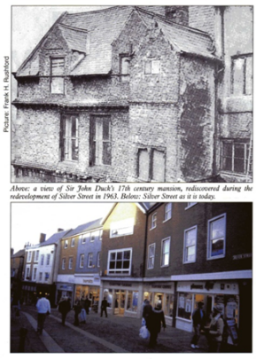
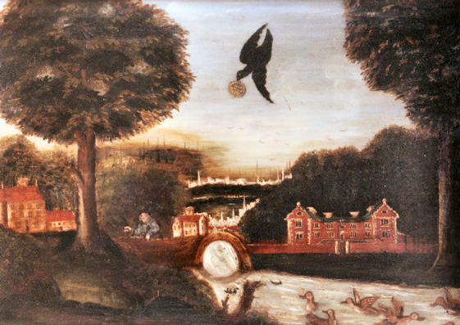
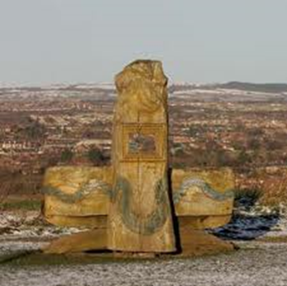
John Duck arrived in Durham as a young man in 1655 with a dream of becoming a butcher’s apprentice, though from an entry in the guild registers it appears that there was some opposition raised to him following the trade. The foundation of his subsequent fortunes is said to have been laid by the following incident. 'As he was straying in melancholy idleness by the water side, a raven appeared hovering in the air, and from chance or fright dropped from his bill a gold Jacobus at the foot of the happy butcher boy.' This adventure was depicted on a panel in the house which he afterwards built for himself in Durham, where he became exceedingly prosperous, and in 1680 served the office of mayor. Taking an active part in politics during the last years of the Stuarts, he attracted the attention of the government, and in 1686 his useful loyalty was rewarded when he was created a Baronet, of Haswell-on-the-Hill in the County of Durham, named after the manor he had purchased with his accumulated wealth in the year of his mayoralty. He built and endowed a hospital at Lumley, but as he had no issue his title became extinct at his death, 26 August 1691. His wife Anne died on 14 December 1695 and lies beside him.
On her death, as they had been childless, the estate passed to her nephew, James Nicholson of Rainton, with the proviso that the Lumley hospital’s upkeep be maintained. James Nicholson died in 1727 and left the estate to his three daughters. Jean married Thomas, Earl of Strathmore in 1736; Ann married a relative of the Earl, Patrick Lyon; Mary remained a spinster and on her death left her third of the estate to John, Lord Glamis, who in due course succeeded to the earldom of Strathmore.
It is not known exactly where Jean and Thomas met but it is known that Thomas had spent a good deal of his younger life in England rather than Scotland since he had been educated at Cambridge University. The period from 1710 until 1746 was a period of great political instability in Scotland due to the rise of the Jacobite's. The Act of Union in 1707 joining the governments of Scotland and England helped to stabilise Scotland, but the re-awakening of political turmoil in 1715 and 1745 with the Jacobite risings did little to settle things down.

Slide 7
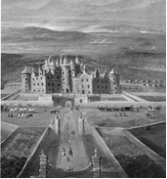
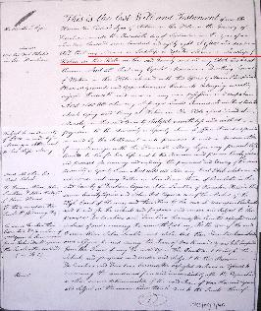
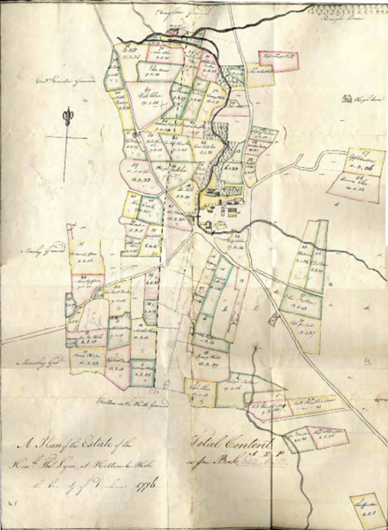
LYON FAMILY AT HETTON
Will of Thomas Lyon
Lord of Hetton-in the-Hole
Glamis Castle Late C17th
In Scotland the retainers at Glamis looked on Thomas as an absentee landlord and the family historical records make little note of this period. Nine years after the marriage in 1745 politics again intervened with the second Jacobite Rising. When fighting took place at Newcastle-upon-Tyne and places further south, the Earl took no opportunity to join in and assist Charles Stuart but kept the presence of his family low on the horizon. His land and estates (part of the Nicholson assets) in the area of Moorsley where a number of messuages (farms), cottages and outbuildings were located must have been the centre of his world. Additionally the social life of the area was a very active one with the Earl and his wife fraternising with many of the newly emerging coal-owning families living locally. These included George Bowes who resided a few miles away at Gibside Hall.
Thomas Lyon 1776 Plan of Hetton-le-Hole Estate

Slide 8
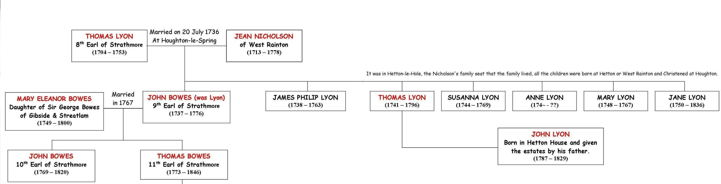
THOMAS LYON 8th EARL FAMILY TREE IN Co DURHAM
In the sixteen years of married life up to the death of the 8th Earl, seven children were born into the family. Many of the children were to do well, both in marriage and in status. It seems that their mother played a dominant part in their upbringing. The children are as follows:-
John Lyon (later known as Bowes following his marriage to Mary Eleanor Bowes, daughter of George Bowes), 9th Earl of Strathmore and Kinghorne (1737-1776)
James Philip Lyon (1738-1763)
Hon. Thomas Lyon (1741-1796) Married Mary Wren, Their daughter Charlotte Lyon (d. 1871) married Revd. Henry George Liddelll (d. 1872) and son of Sir Henry Liddell 5th Bart. They lived at Binchester Hall near Bishop Auckland.
Mary Lyon (d. 1767)
Susan Lyon (d. Feb. 1769) and who married John George Lambton in 1763.
Anne Lyon (c. 1753 - ?) married to John Simpson. Their daughter Maria Susannah Simpson married Thomas Liddell, 1st Baron Ravensworth died (youngest son of Sir Henry Liddell 5th Bart, younger brother of Revd. Henry George Liddell (above)
Jane Lyon (d. 1836)

Slide 9
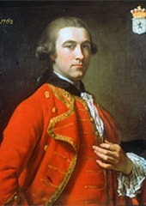
JOHN LYON (LATER BOWES) 9th EARL OF STRATHMORE
John the oldest of the three brothers was just sixteen when his father died. On his father’s death there was pressure from the guardians of the Scottish side of the family that he should return to Scotland to continue and finalise his education at a Scottish University. The guardians were aware that if he remained in England he would undoubtedly come into contact with richer aristocrats of the 18th century society and this would mean living beyond his means. His protective mother on the other hand was insistent that he remain in England and attend an English University. She won the day and on the 3rd March 1755 he enrolled at Pembroke College, Cambridge. His brother James, a year younger and brother Thomas, four years younger, followed him to Cambridge.
John settled in quickly at Cambridge where he was welcomed by Thomas Gray the poet, who wrote “Elergy Written in a Country Churchyard”. He gained two personal tutors Henry Tuthill and the Rev James Brown however at the beginning of 1757 the former was dismissed by the college authorities amid sensation charges of misconduct, which emerged as homosexuality, possibly with Gray and conceivably with others including the young Lord Strathmore.
It has never been stated openly what happened in January 1757 for Tuthill to lose his fellowship and he drowned himself a short time later, that same year. Needless to say there was never any disclosure at Durham concerning the irregularities further south and the Strathmore boys continued with their studies running up a fine bill for their mother to cover in fees.
By 1760 the Earl was engaged in the “Grand Tour”, an absolute certainty for most of England’s male aristocrats. After visiting Portugal and Spain by October Lord Strathmore was in Italy making use of all the tourist spots and cities throughout the country. By March of the following year he was engaged in a passionate affair in Parma with the Countess Santavali. In February 1762 he was in Rome where he had his portrait painted and it wasn’t until the summer of 1763 that he returned to England shortly before the death of his brother James who was murdered in India by the Nabob of Bengal, having been there working for the East India Company. This alarming development meant that he drew closer to his youngest brother Thomas who had just left Cambridge.
Strathmore came back to England having tasted the good life on the continent and even though he had accumulated debts, being young at twenty six, eligible and good looking he did not change his flamboyant lifestyle. He took little interest in the affairs in Scotland and Glamis continued to deteriorate, until late in 1763 he finally took on his responsibilities when he started to draw up plans to improve his circumstances and do something to start work on his property.
"the beautiful Lord Strathmore".
Described by Jesse Foot thus:
"The late Earl of Strathmore was not calculated to make even a good learned woman a pleasing husband. His Lordship's pursuits were always innocent and without the smallest guile, but they were not those of science or any other splendid quality. A sincere friend, a hearty Scotchman and a good bottle companion were points of his character."

Slide 10
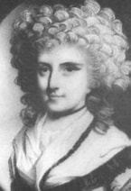
JOHN BOWES (WAS LYON) 9th EARL OF STRATHMORE
John began to look around for a possible rich heiress who could provide the funds he needed and soon made contact with the daughter of his old friend George Bowes. He had last seen Mary Eleanor Bowes when she was only eleven and now at the age of sixteen she was very much matured, having grown up in a precocious manner since her father’s guiding hand had been lost with his death five years earlier. It was a common practice in the 18th century for English and Scottish aristocrats, following the lead of their Irish compatriots, to deliberately go out fortune hunting by looking for a rich eligible lady. This period saw the rise of many families, accumulate quickly great amounts of surplus cash, built on the back of industrial development. This was certainly the case of George Bowes, who lived a mere eleven miles from the Strathmore family home at Hetton. For George Bowes who had recently moved to a new family mansion at Gibside, from his original home at Streatlam Castle near Barnard Castle, he became even richer as he invested in local coal mines and dabbled in lead mines in nearby Weardale.
Thus the Earl through a mutual family friend made contact with the young Mary Eleanor Bowes, thirteen years his junior. By late 1765 an engagement between the two families had been agreed and this was followed up in February 1767 with marriage. Marriage regulations at this point of time, meant that Lord Strathmore now took control of one of the greatest fortunes in the country, as married women were barred by law from owning land or property, or even enjoying a private source of income. What was probably even worse, was the fact that the women virtually became the property of the husband also, effectively having no legal status. However a condition of the marriage had been made prior to the death of George Bowes, in that he insisted whosoever married his precious daughter Mary Eleanor, had to take the surname of Bowes as his family name, a small price to pay for the receipt of a fortune.
The marriage of Mary Eleanor Bowes, heiress to the Bowes estates in County Durham to John Lyon, 9th Earl of Strathmore, was a merger between two ancient families, one English and one Scottish. The change of name from Lyon to Bowes for the next 50 years was symbolic of this union and continued with later generations when the name Bowes-Lyon was adopted.
Mary Eleanor Bowes
(1749-1800)

Slide 11
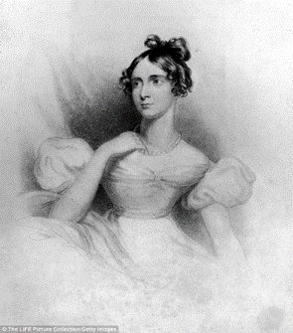
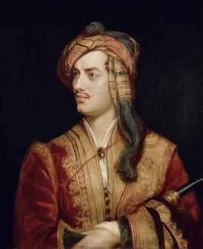
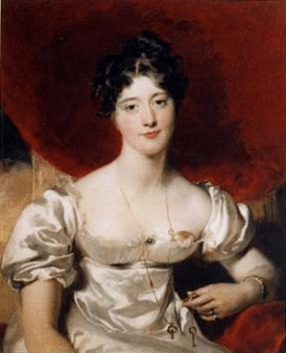
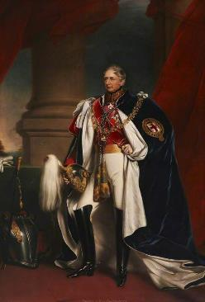
OTHER WEALTHY HEIRESSES IN CO. DURHAM
Provincial heiress Annabella Milbanke, met her future husband, the poet Lord Byron, at Lady Caroline Lamb’s morning waltzing party in 1812. She was later to become his wife, her family home was Seaham Hall where Annabella married Lord Byron in 1815. She was only married to the poet for a year and it was a miserable fiasco from day one. Byron, a serial womaniser who referred to sexual encounters as ‘hot luncheons’, married Annabella only so he could get his hands on the fortune she was due to inherit, and use the respectable marriage to camouflage his ongoing incestuous relationship with his half-sister, Augusta Leigh. Terrified that her husband was going to murder her, Annabella ran away to her parents, taking one-year-old Ada with her. Neither of them ever set eyes on Byron again.
A possible charge of murder frightened him out of his wits. That, combined with his fear of being convicted for sodomy and incest, forced him to sail away to exile in Italy. He died of a fever eight years (and nobody know how many ‘hot luncheons’) later, aged 36.
Annabella Milbanke,20
Lord Byron
Frances Anne Vane, Marchioness of Londonderry was a wealthy English heiress and noblewoman. She was the daughter of Sir Henry Vane-Tempest, 2nd Baronet. She married Charles William Stewart in 1819, 1st Baron Stewart, great friend of the Duke of Wellington. She became a marchioness in 1822 when Charles succeeded his half-brother as 3rd Marquess of Londonderry.
She became an object of affection for Tsar Alexander I after he happened to see her engagement portrait.
When her husband died in 1854, she commissioned an equestrian statue showing him as a hussar, which was unveiled in 1861 and still stands on the market place in Durham.
Through her daughter, Lady Frances Vane, wife of John Churchill, 7th Duke of Marlborough, she is the great-grandmother of Sir Winston Churchill.
Frances Anne Vane,Marchioness of Londonderry
(1800 – 1865)
Charles William Stewart,
1st Baron Stewart,
Marquess of Londonderry
(1778 - 1854)

Slide 12
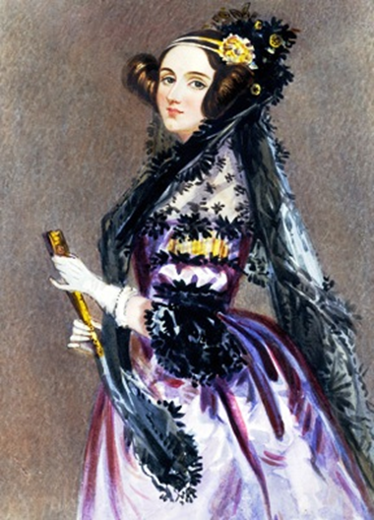
ADA LOVELACE
Ada Lovelace is widely held to have been the first computer programmer. Close friends with inventor Charles Babbage, Lovelace was intrigued by his Analytical Engine and in 1842, she translated a description of it by Italian mathematician Luigi Menabrea. Babbage asked her to expand the article, "as she understood [it] so well", and this was when she wrote several early 'computer programs'. Ada Lovelace died of cancer at 36, her potential tragically unfulfilled. She is so well respected that there is even an Ada Lovelace Day which aims to raise the profile of women in science, technology, engineering and maths by encouraging people around the world to talk about the women whose work they admire.
She is associated with Hetton-le-Hole in County Durham, through her mother Annabella (Anna Isabella) Milbanke who was born at Elemore Hall, situated some two miles south west of the town. She was later to become the wife of Lord Byron, her family home was Seaham Hall where Annabella married Lord Byron in 1815. The drawing-room where the ceremony took place still exists, but has none of the original furnishings.
Byron had doubts as to his marriage and the necessity to him to reform' keep surfacing in the letters of this period. Annabella had turned him down before and Byron seems to hope for the like again, though no doubt flattered that she had refused six suitors before him. There was usually a touch of mockery in his description of her virtues and her talents; her interest in mathematics caused him to dub her his 'Princess of Parallelograms'. Ada’s parents separated after a year of marriage, one month after she was born. The dowry for the marriage had cost her father £20,000 causing him to mortgage his land, which was put up for auction in 1821, subsequently allowing them to be bought by Lord Londonderry for the building of Seaham Harbour.
Augusta Ada King
Countess of Lovelace

Slide 13
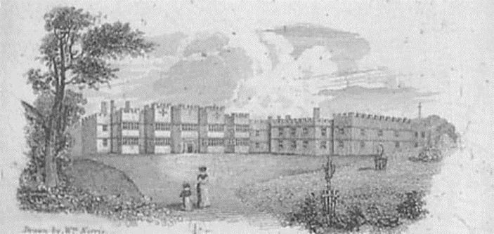
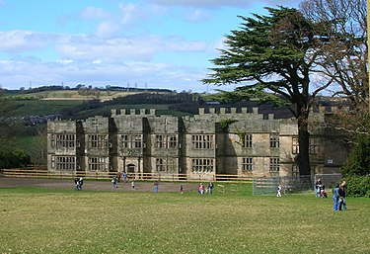
MARY ELEANOR BOWES MARRIAGE TO JOHN 9th EARL STRATHMORE
Mary’s father George had first married Eleanor, daughter and heiress of Hon. Thomas Verney. There is no question that this was a love match, unlike many marriages of convenience which took place at that time. Unfortunately Eleanor died before the end of the year and George was devastated at his loss. It took him twenty years before he remarried, in 1743 to Mary, heiress of Edward Gilbert. The marriage was blessed with only one child. Her father lavished praise on her, she took to most subjects easily. She became an expert linguist and also at a young age could write well having a literary talent beyond her years, she was tutored at home by excellent scholars. George also physically tried to bolster his daughter with riding and hunting.
The marriage to the 9th Earl produced five children in nine years. Mary soon realized that she was locked into a loveless marriage with a man who had nothing in common with her passions or dreams. Strathmore had picked up again with his Cambridge mates Gray and the Rev. Brown who regularly came north to visit him. He enjoyed the country life with its country sports of hunting and riding while his wife remained at home. Their lifestyles were totally incompatible. Mary took a much greater interest in botany and she embarked upon the building of a large greenhouse at Gibside to follow her passion. She also took an interest in other men, one in particular, George Gray, an entrepreneur with the East India Company, made an impact upon her. As the winter of 1775/6 proceeded Mary complained of illness, meanwhile her husband who had been ill for a number of months set off to Portugal and warmer climates to combat tuberculosis. He never reached Portugal for, on the 7th March 1776 as the ship approached Lisbon Lord Strathmore died. It took a month for the notice of his death to reach Mary, by which time she was pregnant with the child of George Gray.
She was now alone with her five children, Mary although outwardly showing all the passion of losing a loving husband, inwardly felt free from the shackles of a loveless marriage. Thomas Lyon, was looking out for every opportunity to discredit Mary and if a child was born out of wedlock, a distinct possibility, she was forced to carry out an abortion on the child she was carrying. A miscarriage took place, but Mary didn’t learn from the experience as she became pregnant a further three times during the summer and autumn of 1776. Further “emetics” were taken by her on each occasion to end the pregnancy and on each occasion she was successful. Gray continued to visit he in secret, at least those who would have liked to know, didn’t find out and scandal was avoided. Gossip, however, soon surfaced among the socialites in London concerning the affair and eventually this reached the ears of Thomas.
Gibside Hall
Shell of Gibside Hall

Slide 14
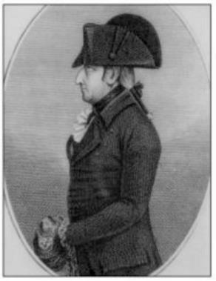
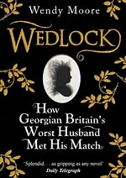
ANDREW ROBINSON STONEY BOWES
Thomas Lyon, together with two other guardians, would gain influence over the five children Maria, Anna, John, George and Thomas.
Andrew Robinson Stoney flatters Mary and is welcomed into her circle of friends.
1778 Mary pregnant for 4th time to George Gray.
Stoney plants anonymous and derogatory stories about Mary’s lack of morals in the gossip columns.
Challenges the editor of the paper to a duel to defend Mary’s honour.
Mary finds Stoney, wounded, bleeding and close to death, was flattered by his devotion.
Tells her his dying wish was to be her husband, she agreed, expecting he would be dead within days.
Mary had no idea that Stoney had staged the duel, bribing the newspaper editor and a doctor, to say he was nearly dead.
Rallying from his deathbed to invite his family to drink from Mary’s ample cellar.
Start of eight years of a violent marriage, each year worse than the last.
From the start he sets rigid curbs on Mary’s activities, censoring all her mail, banns her family and friends. Forces the servants to spy on her.
Then the violence began. If Mary did anything to annoy her husband, he would punch, kick or slap her, beating her with the hilt of his sword or a silver candlestick.
Discovers her wealth signed over to her children, gives her a ferocious beating, forcing her to sign a paper revoking the earlier document and transferring control of all income and profits to him.
Mary wrote: ‘He beat me several times, once with a thick stick heavy with lead, and with a horsewhip.
There was little she could do in her defence. Not only was marital violence common and tolerated, it was supported by law, husbands could beat their wives lawfully to ‘keep them to their duties’.
A new servant Mary Morgan was appalled by the abuse she witnessed and agreed to help Mary escape.
From her hiding place Mary launched legal proceedings to divorce Stoney.
Hearing of this he hired a group of hoodlums to kidnap her in broad daylight. They fled to the North, with the police and Mary’s supporters in hot pursuit. For ten days they tried to get her to surrender. Stoney was found guilty of assault and jailed for three years. Mary had been so weakened by her ordeal that she could not stand for a month or walk across a room for six weeks.
It would take four years - due in part to Stoney’s cunning and prevarication - before she divorced him on the grounds of cruelty.
Andrew Robinson Stoney
Wedlock by
Wendy Moore

Slide 15
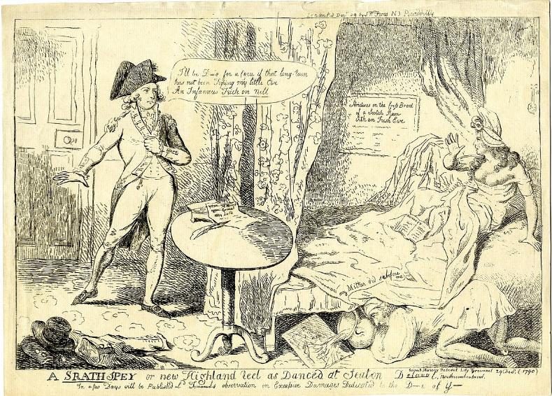
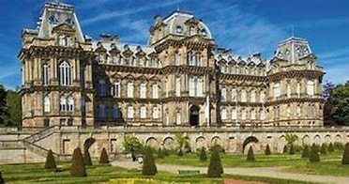
JOHN BOWES 10th EARL OF STRATHMORE
"I'll be D--d for a Cocu if that long ram has not been Tuping my little Ewe An Infamous Trick on Nell [Tyrconnel]".
'Strictures on the Cross Breed of a Scotch Ram with an Irish Ewe'.
'Notoriety'
John Lyon, Lord Strathmore delayed marriage since he was smitten with a married lady the young Sarah, Countess of Tyconnell. A stunning beauty of the time, the Countess captivated the young earl and he was befriended by her broad minded husband. In 1792 he bought Claremont Lodge, only a mile away from Claremont House, but when they were in the North, he and Sarah lived openly at Gibside. Unfortunately in 1806 she contracted tuberculosis and with her lover at her side she died only six months after he had lost his mother.
For nine long years he could not face another love attachment, until he met a 22 year old maid Mary Milner, who worked at his shooting lodge Wemmergill House. He treated her as his wife and she gave birth to an illegitimate child who was named John Bowes after his father. Acknowledging young John as his heir, he tried to legitimize their son, and following a serious bout of illness, went through a marriage ceremony with his beloved Mary on July 2nd 1820. The following day the Earl died, but although John Bowes inherited both Gibside and Streatlam castle, he was not allowed to inherit the Scottish Estates, since the Strathmore title now went to his father’s younger brother Thomas.
Young John Bowes successfully looked after the Bowes interests in County Durham and following a series of spells when he lived in Paris, he returned to build the Bowes Museum which now holds many of the artifacts which were collected by him and his French wife.
'My Lord’
A Strath spey or new Highland reel as danced at Seaton d-l. [delaval]
"my Mither did sa before me"
The Bowes Museum

Slide 16
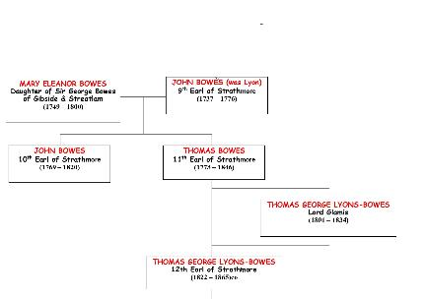
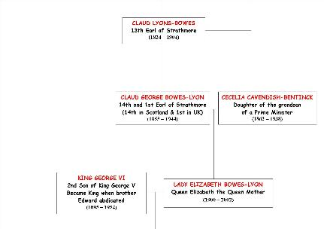
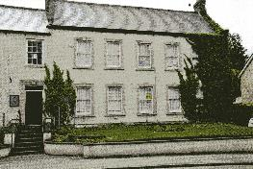
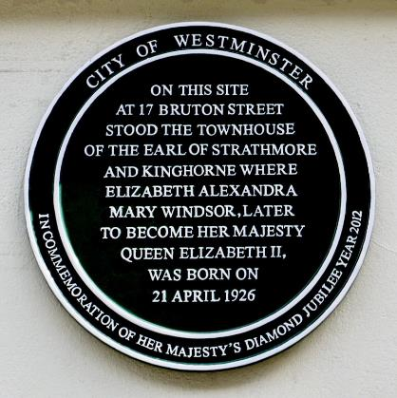
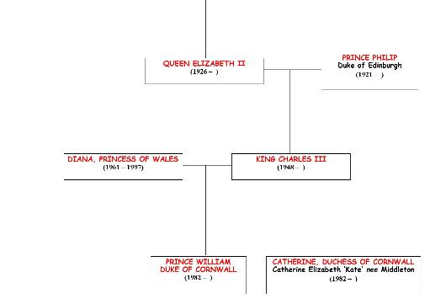
FROM THOMAS BOWES 11th EARL TO CLAUDE GEORGE BOWES-LYON 14th EARL
Mary died at Stourfield in 1800 aged just fifty one years. She was buried in Westminster Abbey, close to the graves of her beloved poets, Chaucer, Spenser and Dryden. Of her children, Maria Bowes, lived comfortably in Gloucestershire but unfortunately died young aged thirty eight in 1806. Her younger brother George died a year later a mere thirty five years old. Thomas the youngest boy was married three times. He outlived two of his wives and also his only son and heir. As for little Anna she was widowed early and she lived on the Gibside estate for most of her life, finally dying in 1832 aged sixty one.
The line of succession which followed for the Lyon family meant that by the time of Claude the 14th Earl of Strathmore (1855-1944) who changed his name to Bowes- Lyon had six sons and four girls, one of whom was Lady Elizabeth Bowes Lyon. She was to marry the future King George VI and have two children, the former Queen Elizabeth II and Princess Margaret. The Queen married in 1947 the Duke of Edinburgh and they had four children, Charles (now King), Ann, Andrew and Edward. The now King Charles III married Lady Diana Spencer and they had two boys Prince William and Prince Harry one of which will figure in a later connection.
Hetton House
(now privately owned)
Thomas Lyon was succeeded by his son John, by 1812 John was married and living in Hetton House. It was John who tried unsuccessfully to sink the first colliery in the concealed coalfield in 1810. He was still living in Hetton House when he signed leases of land and coal to Archibald Cochrane and his partners in the HETTON COAL COMPANY.

Slide 17
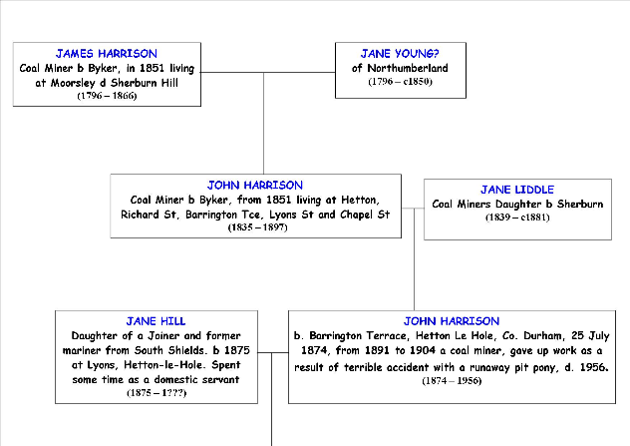
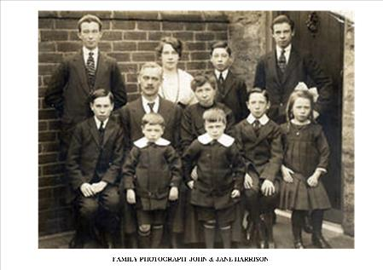
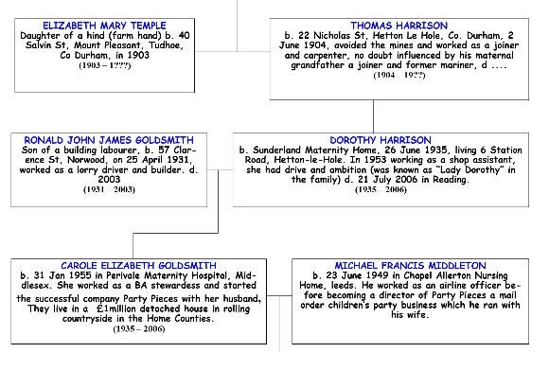
The Duchess of Cornwall’s Northern Ancestors, the Harrison Family
The Harrison family were originally lead miners at Fallowfield near Hexham and Corbridge in Northumberland. It was her great-great-great-great-great grandfather, James Harrison who became a coalminer at the Byker Colliery on the outskirts of Newcastle. His son, James, followed him down the pit, he married Jane Armstrong in 1825, they had six children, all born in Byker.
With the opening of new coal mines throughout County Durham many families moved south and by the 1851 census James had joined them. They were living in a miner’s cottage at Blue Row, Low Moorsley close to Hetton-le-Hole. Later the family moved to Sherburn Hill where John Harrison met and married Jane Liddell in 1860. By 1871 John Harrison and, his family had moved to the Downs area of Hetton-le-Hole, a developing town, where the family would grow to have ten children. A series. of tragedies followed for the Harrison family.
Tuberculosis was a common disease among communities and thrived in the lifestyle of most families where they lived in cold, damp and crowded conditions. Mother Jane, aged just 42 years died in 1881 leaving John with 10 children between the ages of 2-21 years. Daughter Isabella, died aged 18 years in 1888, followed by father John, aged 54 years in 1889. Tragedy struck again when James, aged 17 years, a coal putter, died in December 1889, also from tuberculosis. By the 1891 census John (16) and his sisters Mary (24) and Alice (11) were lodgers in Richard Street Hetton. Elizabeth (14) was working in nearby Hutton Street as a domestic servant.
CATHERINE, DUCHESS OF CORNWALL
Catherine Elizabeth ‘Kate’ nee Middleton (1982 – )

Slide 18
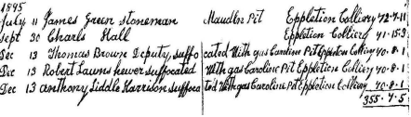
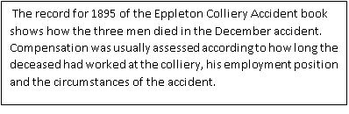
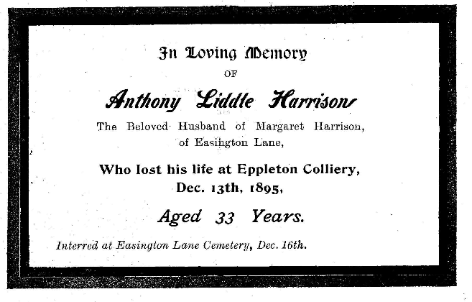
ANTHONY LIDDLE HARRISON – 13th DECEMBER 1895
On 13th December 1895 a pit disaster claimed the life of older brother Anthony Liddell Harrison.
At 11.30 a.m. on that morning Anthony, 34 years, a hewer, went to the rescue of Deputy John Thomas Brown and putter Robert Lawns who had entered an area to get an empty tub and were overcome by a foul gas. These two men should not have been in that location and Anthony attempted to rescue them when they failed to emerge from that area. Anthony too succumbed to the effects of the gas.
Anthony left behind a wife and two young children 2 and 8 years of age. Below is a portion of the accident book for Eppleton Colliery, where the men worked, for the period of 1895. The accident book was a record of accidents and disasters in the colliery, their cause and the level of compensation given to the deceased or injured.
Anthony was recognised as a hero and his efforts were duly recognised by the Mines Inspectorate in their 1895 Report of the accident.
“ I should like to say a word or two in appreciation of the courage and gallantry shown by the men who were amongst the rescuers. The three hewers, as well as the manager, under manager, overman and back overman, all showed that they possessed the qualities which in the past made pitmen famous for heroism in the time of danger, such conduct as theirs should not go without commendation, and I am pleased to have the opportunity in this report, to show my appreciation of it, and I regret that one of them should have lost his life in the plucky attempt made to rescue Brown and Lawns”
.”

Slide 19
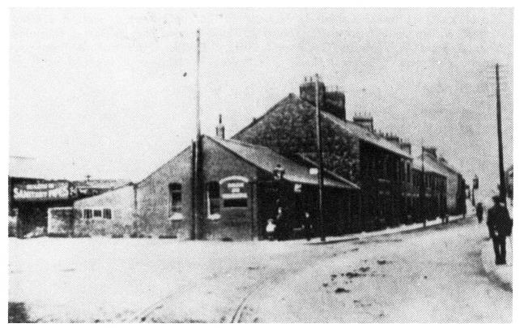
THE FAMILY OF JOHN AND JANE HARRISON
John Harrison, Kate’s great-great grandfather, was living at 18 Downs Lane, Hetton-le-Hole, when he married Jane Hill, a domestic servant of 1, Barrington Terrace, at the Register Office in the District of Houghton-le-Spring on 23rd February 1875, shortly after the family moved from Sunderland. Father, Thomas Hill became a colliery joiner.
John and Jane raised seven boys and two girls Jane 1898, Ernest 1900, John 1902, Thomas 23.06.1904, Wilfred 1906, Norman 1908, Gladys 1912 and (twins) George & Albert 1914.
During this time the family moved around the Hetton area from Chapel Street to Nicholas Street, Blossom Street, Kenton Row then Barrington Terrace. John and Jane Harrison then moved to Easington Lane and in later life to Broomhill Estate, Hetton-le-Hole.
In spite of a pit accident at Eppleton Colliery when father John Harrison was badly injured, having been kicked by a pit pony, he still lived until he was 82 years of age. However he never returned to work. He died in Ryhope hospital on 25th September 1956. His wife Jane, also died in Ryhope hospital on 27th May 1957 aged 81 years. Thomas Harrison, Kate’s great grandfather, was the first son to break with the family’s mining tradition to become a carpenter,
It was 1930 when Wilfred, an apprentice blacksmith and toolmaker, left Durham for London with his heavily pregnant girlfriend Bessie, a nurse, by train in a 3rd class carriage. Wilf would establish himself as an engineer, studying at home and setting up his own toolmaking company with brothers Jack, Albert and after the war Thomas. The first step for the Harrison family to the middle-classes and ultimately royalty.
.
The absentee electoral rolls for 1930-1933 indicate that Thomas Harrison was attached to the Northamptonshire Regiment, his home address being 7 Derwent Steet then 7 Girven Terrace, Easington Lane where his parents were living. Thomas married Elizabeth Mary Temple (who had an illegitimate daughter Ruth) on 12th May 1934 in the parish church at Tudhoe, where Elizabeth, a farm worker’s daughter, had been baptised on 4th March 1903.
The couple obviously moved to Hetton-le-Hole shortly after marriage because, when Dorothy, Kate's grandmother, was born at Sunderland Maternity Home, 2-4, Mowbray Terrace on 26th June 1935, her parents were living at 6, Station Road. Dorothy was baptised in St. Nicholas Church, Hetton-le-Hole on 10th July 1935
6 Station Road, Hetton-le=Hole
Notes:
After the war

Slide 20
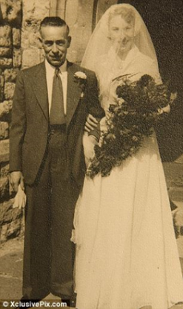
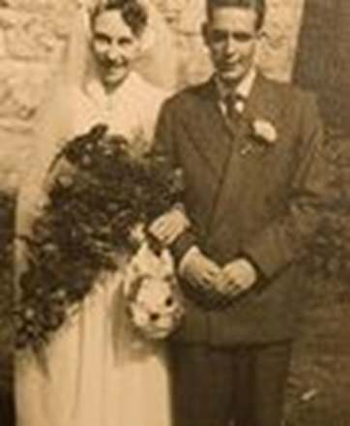
THOMAS HARRISON MOVES TO LONDON AND UP THE SOCIAL LADDER
Inspired by brother Jack the couple moved to London after Tommy returned from serving in Malaya during the war. Virtually penniless, they lived in a run-down house in Bankside, Southall, where Thomas kept chickens.
Dorothy Harrison met Ronald Goldsmith at a friend’s wedding even though the Goldsmith family lived only a couple of miles away from the Harrisons. Dorothy was working as a sales assistant for Dorothy Perkins whilst Ron was working in his brother-in-law’s haulage company. The couple married in Holy Trinity Church, Southall on 8th August 1953 when Dorothy was 18 years of age. Although both from working class backgrounds, with little money or education, they were soon to climb the social ladder. It would appear that Dorothy had drive and ambition.
Dorothy’s father Thomas Harrison died at home in North Road, Southall on 24th August 1976 aged 72 years and her mother Elizabeth on 1st December 1991 in a nursing home in Southall, aged 88 years.
Ronald Goldsmith died on 10th September 2003 at their home in Pangbourne Berkshire, and his wife Dorothy in the Royal Marsden Hospital on 27th July 2006. Thus the connection with Hetton-le- Hole ended here.
The following year their elder daughter Carole was born and 10 years later brother Gary arrived. Nicknamed “Lady Dorothy” by her husband’s family because of her airs and graces, she encouraged Ronald to take advantage of the property boom and create a better future for their children.
When Carole married flight dispatcher Michael Middleton, the family’s social status was cemented.
Together they steered their three children through private schools and university into London’s social elite. Sadly Carole did not get to know her great-grandfather John, who instilled in his family the merits of hard work. He died in 1956 when she was barely a toddler.
Dorothy and father Thomas arrive for marriage to Ronald
Harrison Goldsmith Marriage

Slide 21
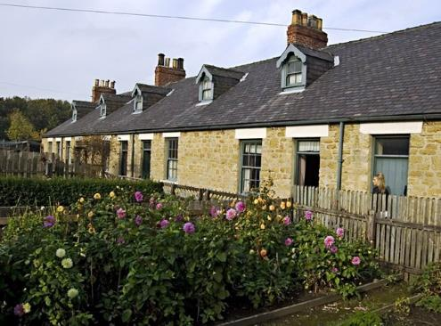
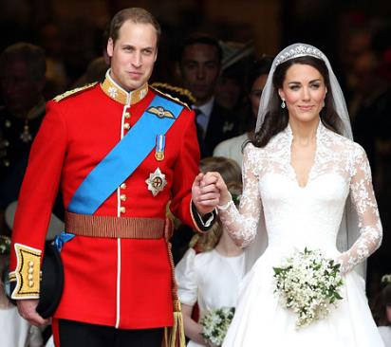
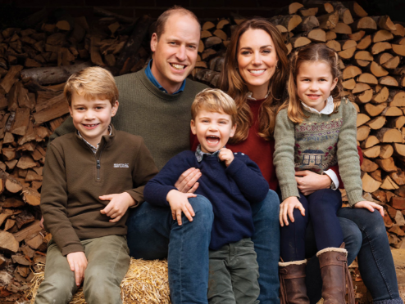
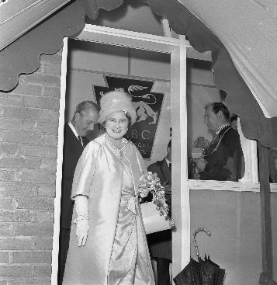
REMEMBER THE MINERS OF HETTON
It should be remembered that the miners of this small north of England town not only formed a community but gave to the area wealth and prosperity which inevitably allowed some of it to assist the coal owners and land owners including the Bowes-Lyon family to maintain their position in life. The late Queen Mother, part of this illustrious family was eventually to have two great- grandsons, one of whom, Prince William, would eventually marry the great-great granddaughter of a Durham miner.
Francis Street,
Hetton Housing at Beamish
Marriage Kate and Will
With children Prince George, Princess Charlotte and Prince Louis.
Queen Mother Opens Lyons Boys Club 1963

